Slide 1
Properties of Trees
A tree with n vertices has n−1 edges.
An full m-ary tree with i internal vertices contains n = mi + 1 vertices.
A rooted m-ary tree of height h is called balanced if all leaves are at levels h or h–1.

Slide 2
Example
Is this tree balanced?

Slide 3
Example
Is this tree balanced?

Slide 4
Example
Is this tree balanced?

Slide 5
Full and Complete Binary Trees
A full binary tree is a binary tree in which each node is either a leaf node or has degree 2 (i.e., has exactly 2 children).
A complete binary tree is a full binary tree in which all leaves have the same depth.

Slide 6
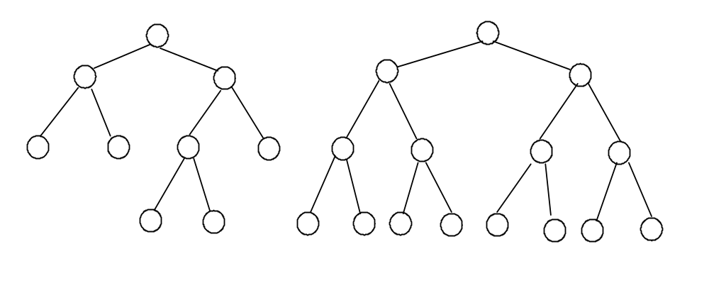
Examples
Full binary tree: Complete binary tree:

Slide 7
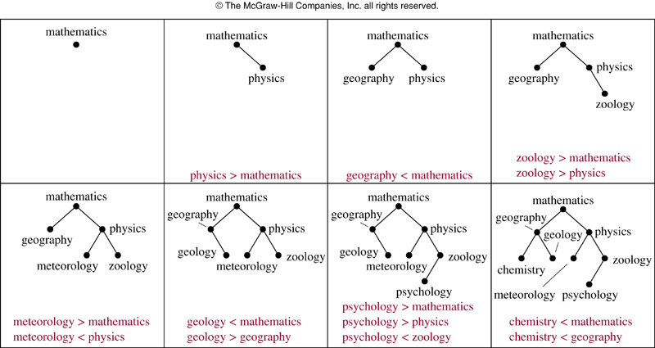
Binary Search Trees

Slide 8
Section 10.3
Tree Traversal

Slide 9
Traversal Algorithms
A traversal algorithm is a procedure for systematically visiting every vertex of an ordered rooted tree
  An ordered rooted tree is a rooted tree where the children of each internal vertex are ordered
The three common traversals are:
  Preorder traversal
  Inorder traversal
  Postorder traversal

Slide 10
Tree Traversal
Pre-order traversal
  Visit node, traverse left subtree, traverse right subtree
  Node-left-right
In-order traversal
  Traverse left subtree, visit node, traverse right subtree
  Left-node-right
Post-order traversal
  Traverse left subtree, traverse right subtree, visit node
  Left-right-node

Slide 11
Example
Tree:
Visiting sequence:
M
A
Y
E
J
R
H
P
Q
T
M
A
J
Y
R
H
P
Q
T
E

Slide 12
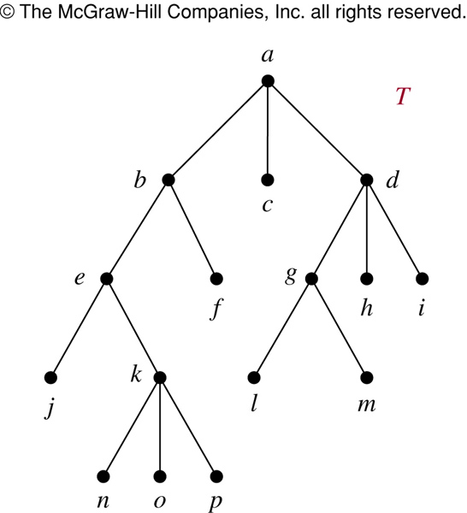
The Preorder Traversal of T
In which order does a preorder traversal visit the vertices in the ordered rooted tree T shown to the left?
Preorder:
Visit root, then visit subtrees left to right.

Slide 13
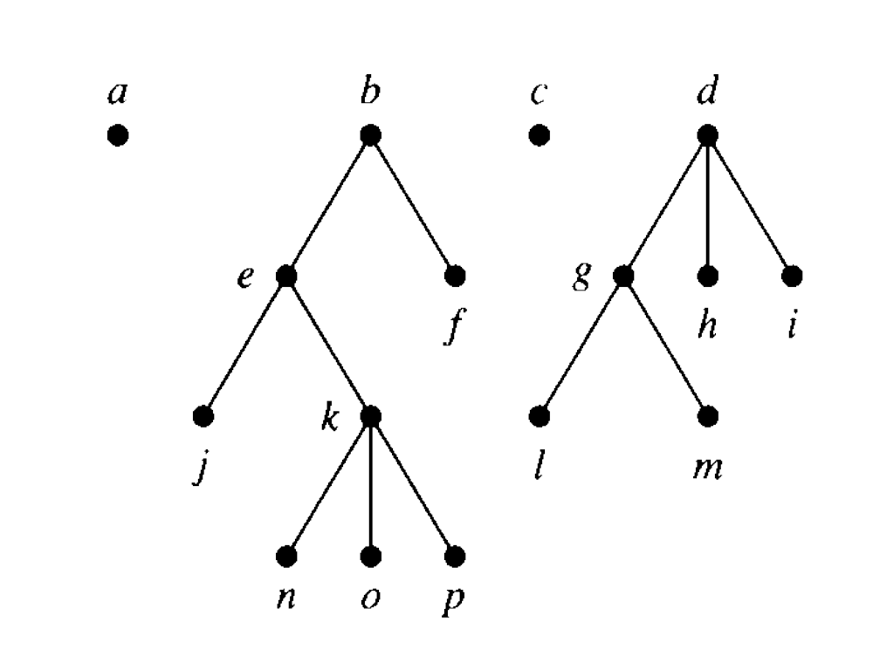
The Preorder Traversal of T
© The McGraw-Hill Companies, Inc. all rights reserved
Preorder:
Visit root, then visit subtrees left to right.

Slide 14
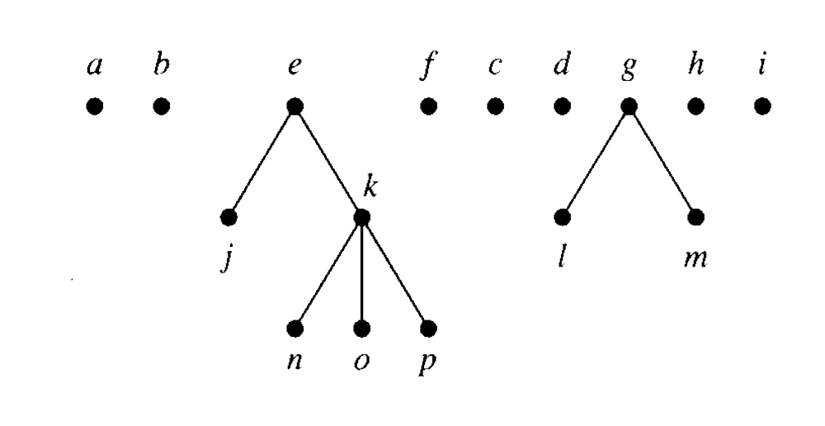
The Preorder Traversal of T
© The McGraw-Hill Companies, Inc. all rights reserved

Slide 15
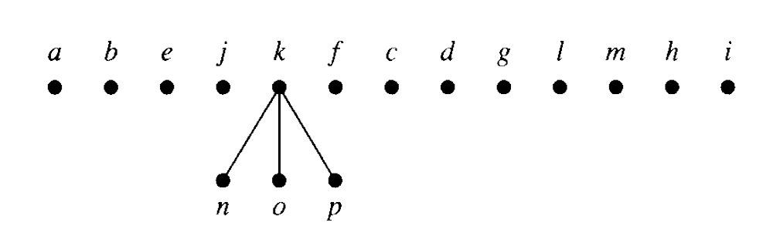
The Preorder Traversal of T
© The McGraw-Hill Companies, Inc. all rights reserved

Slide 16
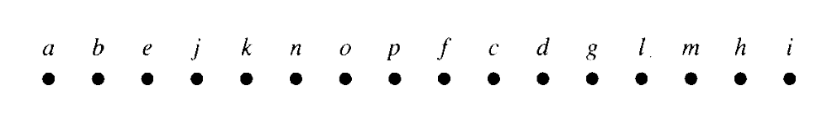
The Preorder Traversal of T
© The McGraw-Hill Companies, Inc. all rights reserved

Slide 17
Example
Tree:
Visiting sequence:
M
A
Y
E
J
R
H
P
Q
T
J
A
M
R
Y
P
H
Q
T
E

Slide 18
The Inorder Traversal of T
In which order does an inorder traversal visit the vertices in the ordered rooted tree T shown to the left?
Inorder:
Visit leftmost tree, visit root, visit other subtrees left to right.

Slide 19
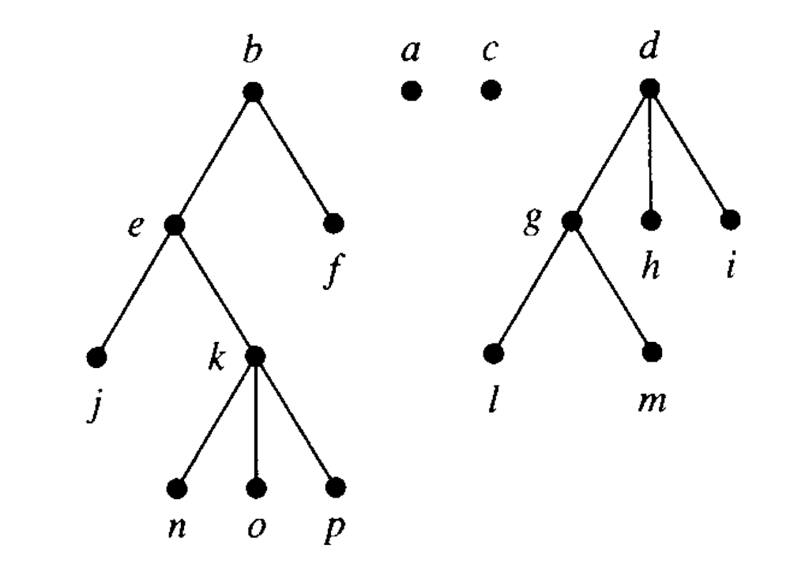
The Inorder Traversal of T
© The McGraw-Hill Companies, Inc. all rights reserved
Inorder:
Visit leftmost tree, visit root, visit other subtrees left to right.

Slide 20
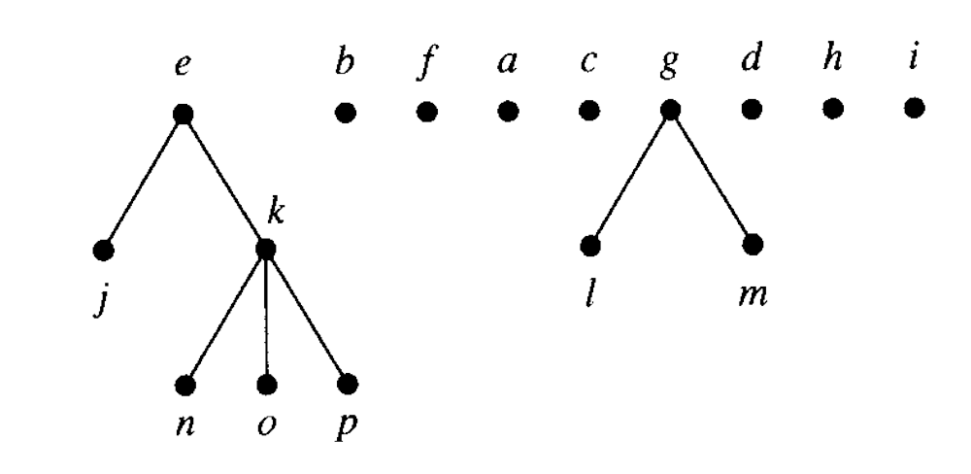
The Inorder Traversal of T
© The McGraw-Hill Companies, Inc. all rights reserved

Slide 21
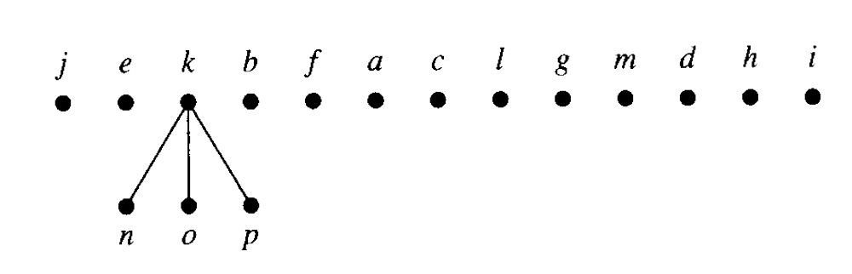
The Inorder Traversal of T
© The McGraw-Hill Companies, Inc. all rights reserved

Slide 22
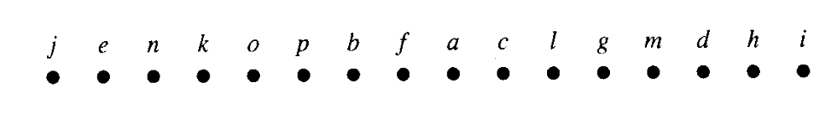
The Inorder Traversal of T
© The McGraw-Hill Companies, Inc. all rights reserved

Slide 23
Example
Tree:
Visiting sequence:
M
A
Y
E
J
R
H
P
Q
T
J
A
R
P
Q
T
H
Y
E
M

Slide 24
The Postorder Traversal of T
In which order does a postorder traversal visit the vertices in the ordered rooted tree T shown to the left?
Postorder:
Visit subtrees left to right, then visit root.

Slide 25
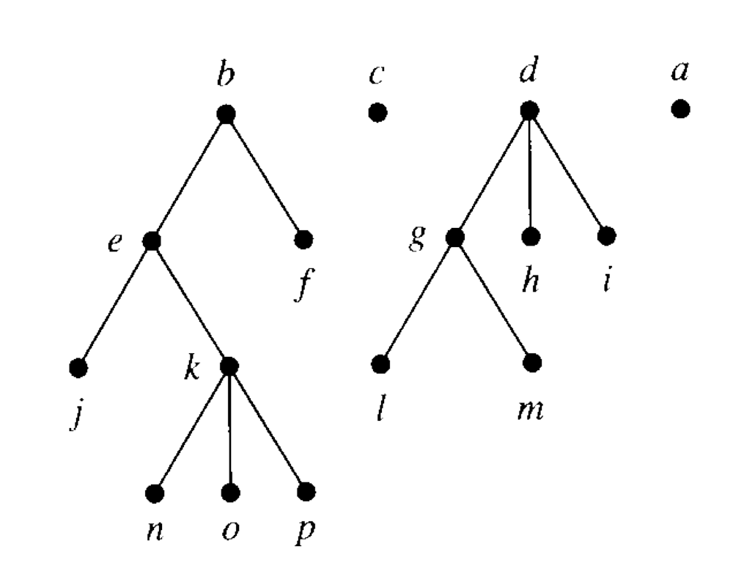
The Postorder Traversal of T
© The McGraw-Hill Companies, Inc. all rights reserved
Postorder:
Visit subtrees left to right, then visit root.

Slide 26
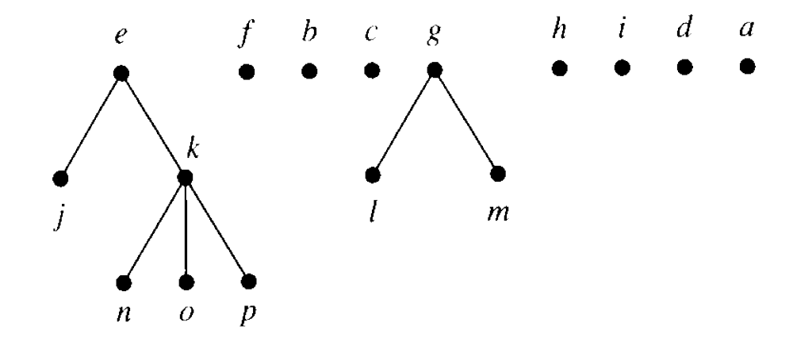
The Postorder Traversal of T
© The McGraw-Hill Companies, Inc. all rights reserved

Slide 27
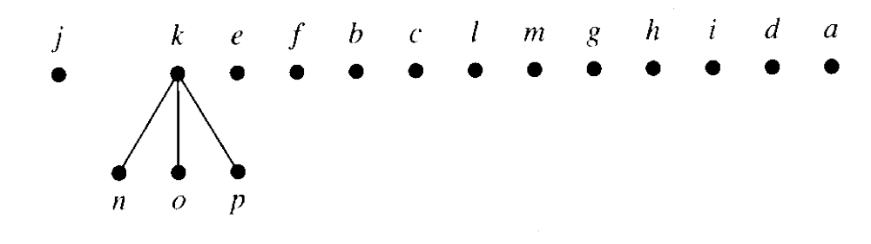
The Postorder Traversal of T
© The McGraw-Hill Companies, Inc. all rights reserved

Slide 28
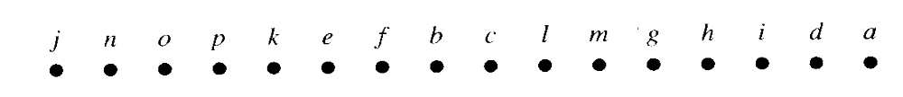
The Postorder Traversal of T
© The McGraw-Hill Companies, Inc. all rights reserved

Slide 29
Representing Arithmetic Expressions
Complicated arithmetic expressions can be represented by an ordered rooted tree
  Internal vertices represent operators
  Leaves represent operands
Build the tree bottom-up
  Construct smaller subtrees
  Incorporate the smaller subtrees as part of larger subtrees

Slide 30
Example
(x+y)² + (x-3)/(y+2)
+
↑
/
+
2
–
+
x
y
x
3
y
2

Slide 31
Infix Notation
Traverse in inorder adding parentheses for each operation
+
↑
/
+
2
–
+
x
y
x
3
y
2
(
x
y
2
+
(
(
+
)
)
x
–
y
)
(
3
(
)
(
+
2
)
↑
/
)

Slide 32
Prefix Notation (Polish Notation)
Traverse in preorder:
+
↑
/
+
2
–
+
x
y
x
3
y
2
+
↑
+
x
y
2
/
–
x
3
+
y
2

Slide 33
Evaluating Prefix Notation
In an prefix expression, a binary operator precedes its two operands
The expression is evaluated right-left
Look for the first operator from the right
Evaluate the operator with the two operands immediately to its right

Slide 34
Example
+ / + 2 2 2 / – 3 2 + 1 0
+ / + 2 2 2 / – 3 2 1
+ / + 2 2 2 / 1 1
+ / + 2 2 2 1
+ / 4 2 1
+ 2 1
3

Slide 35
Postfix Notation (Reverse Polish)
Traverse in postorder
+
↑
/
+
2
–
+
x
y
x
3
y
2
x
y
+
2
↑
x
3
–
y
2
+
/
+

Slide 36
Evaluating Postfix Notation
In an postfix expression, a binary operator follows its two operands
The expression is evaluated left-right
Look for the first operator from the left
Evaluate the operator with the two operands immediately to its left

Slide 37
Example
2 2 + 2 / 3 2 – 1 0 + / +
4 2 / 3 2 – 1 0 + / +
2 3 2 – 1 0 + / +
2 1 1 0 + / +
2 1 1 / +
2 1 +
3

Slide 38
Any Questions?

